Slide 1
Lectuer-11 Database Systems and Applications
Ashish Narang

Slide 2
First Semester
2020-21

Slide 3
Single User Vs Multiuser System
Single-User System:
–At most one user at a time can use the system.
Multiuser System:
–Many users can access the system concurrently.
Concurrency
–Interleaved processing:
Concurrent execution of processes is interleaved in a single CPU
–Parallel processing:
Processes are concurrently executed in multiple CPUs.

Slide 4
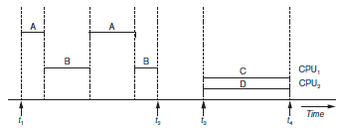
Interleaving and Parallel Processing

Slide 5
Transaction
A transaction is an executing program that forms a logical unit of database processing.
A transaction includes one or more database access operations.
Operations of transaction can be embedded or specified interactively using SQL.
An application program may contain several transactions separated by the Begin and End transaction boundaries.

Slide 6
Database Storage
DB system resides on non volatile storage.
Database is partitioned into blocks of fixed length storage
Transactions input and output data from disk to main memory, and main memory to the disk.
The data transfer is done in terms of blocks.

Slide 7
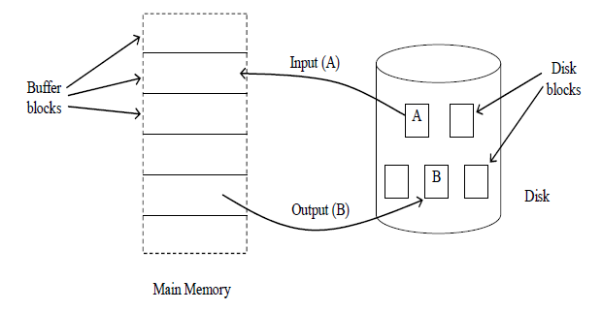
Contd..

Slide 8
Read and Write Operations
Transactions interact with DB by transferring data from program variables to the DB and DB to program variables.
This transfer of data is achieved through the following two operations.
read_item(X, x): Reads a database item named X into a program variable x.
write_item(X,x): Writes the value of program variable x into the database item named X.

Slide 9
Contd..
Read_item(X,x) command includes the following steps:
Find the address of the disk block that contains item X.
Copy that disk block into a buffer in main memory (if that disk block is not already in some main memory buffer).
Copy item X from the buffer to the program variable named x.

Slide 10
Contd..
Write_item(X,x) command includes the following steps:
Find the address of the disk block that contains item X.
Copy that disk block into a buffer in main memory (if that disk block is not already in some main memory buffer).
Copy item X from the program variable named x into its correct location in the buffer.
Store the updated block from the buffer back to disk (either immediately or at some later point in time).

Slide 11
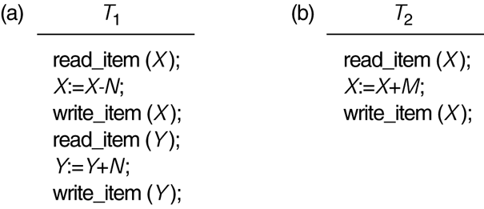
Two Sample Transactions
Two sample transactions:
–(a) Transaction T1
–(b) Transaction T2

Slide 12
Transaction and System Concepts
A transaction is an atomic unit of work that is either completed in its entirety or not done at all.
–For recovery purposes, the system needs to keep track of when the transaction starts, terminates, and commits or aborts.

Slide 13
Contd..
Recovery manager keeps track of the following operations:
–begin_transaction: This marks the beginning of transaction execution.
–read or write: These specify read or write operations on the database items that are executed as part of a transaction.
–end_transaction: This specifies that read and write transaction operations have ended and marks the end limit of transaction execution.

Slide 14
Contd..
–commit_transaction: This signals a successful end of the transaction so that any changes (updates) executed by the transaction can be safely committed to the database and will not be undone.
–rollback (or abort): This signals that the transaction has ended unsuccessfully, so that any changes or effects that the transaction may have applied to the database must be undone.

Slide 15
Desirable Properties of Transactions
ACID properties:
Atomicity: A transaction is an atomic unit of processing; it is either performed in its entirety or not performed at all.
Consistency preservation: A correct execution of the transaction must take the database from one consistent state to another.
Isolation: Execution of a transaction should not be interfered with any other transactions executing concurrently.
Durability: Once a transaction changes the database and the changes are committed, these changes must never be lost because of subsequent failure.

Slide 16
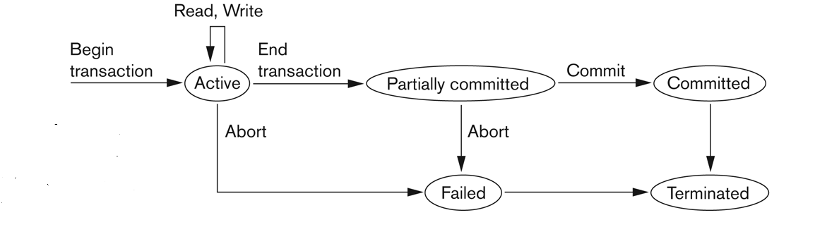
States of a Transaction

Slide 17
Multiprogramming
Multiprogramming in modern systems increases the throughput drastically, as the resources are shared by more than one process.
Similarly in a DBMS multiple transactions are executed concurrently.
A transaction is a collection of operations that perform a single logical operation or function in a database application. Each transaction is a unit of atomicity.
Here, for transactions we consider data items as resources because transactions process data by accessing them.
When multiple transactions access data elements in a concurrent way, this may destroy the consistency of the database.

Slide 18
Why Concurrency Control is needed
The Lost Update Problem
–This occurs when two transactions that access the same database items have their operations interleaved in a way that makes the value of some database item incorrect.
The Temporary Update (or Dirty Read) Problem
–This occurs when one transaction updates a database item and then the transaction fails for some reason.
–The updated item is accessed by another transaction before it is changed back to its original value.
The Incorrect Summary Problem
–If one transaction is calculating an aggregate summary function on a number of records while other transactions are updating some of these records, the aggregate function may calculate some values before they are updated and others after they are updated.

Slide 19
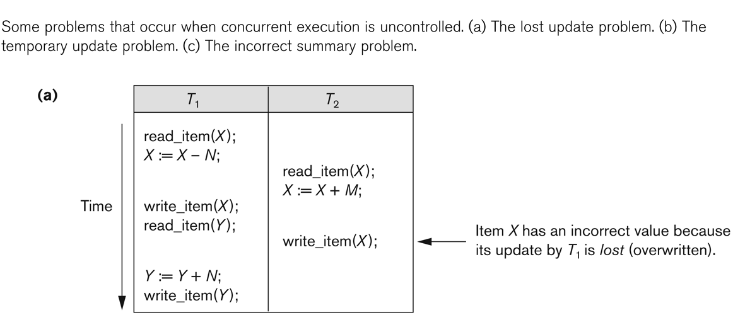
The Lost Update Problem

Slide 20
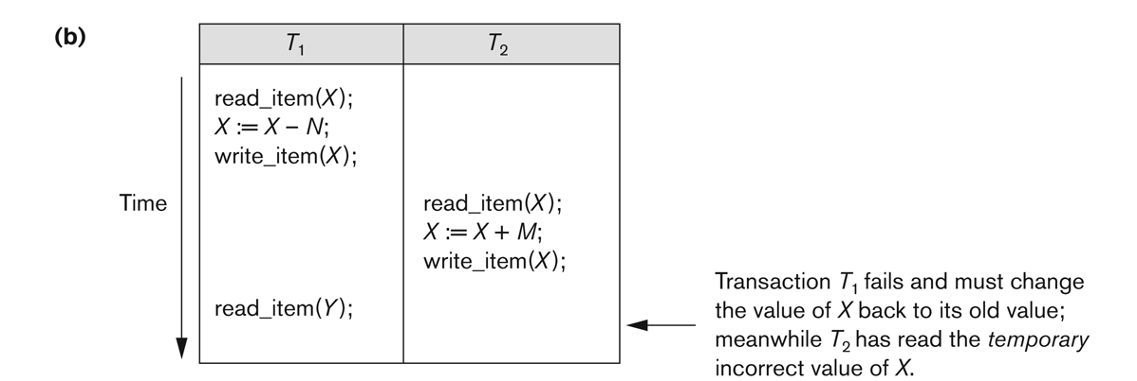
The Temporary Update Problem

Slide 21
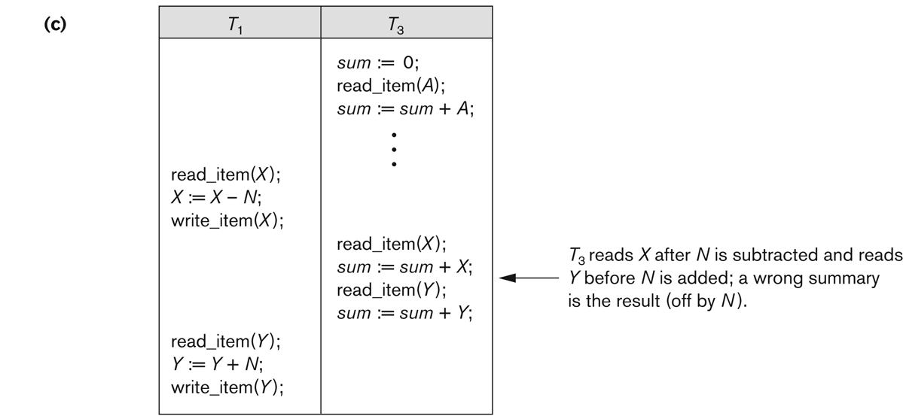
The Incorrect Summary Problem

Slide 22
Transaction Schedule
Transaction schedule or history:
–When transactions are executing concurrently in an interleaved fashion, the order of execution of operations from the various transactions forms what is known as a transaction schedule (or history).
A schedule (or history) S of n transactions T1, T2, …, Tn:
–It is an ordering of the operations of the transactions subject to the constraint that, for each transaction Ti that participates in S, the operations of T1 in S must appear in the same order in which they occur in T1.
–Note, however, that operations from other transactions Tj can be interleaved with the operations of Ti in S.

Slide 23
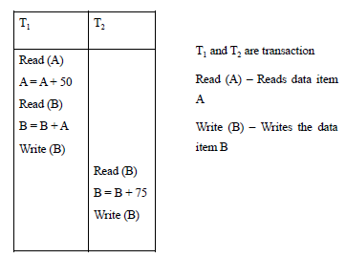
Contd..

Slide 24
Serial Schedule
In a serial schedule, instructions belonging to one single transaction appear together.
A serial schedule always results in correct database state that reflect the real world situations.
A serial schedule does not exploit the concurrency. Hence, it is less efficient.
If the transactions are executed concurrently then the resources can be utilized more efficiently hence more throughput is achieved.

Slide 25
Concurrent Schedule
When the instructions of different transactions of a schedule are executed in an interleaved manner we call such schedules are called concurrent schedules.
This kind of concurrent schedules may result in incorrect database state.

Slide 26
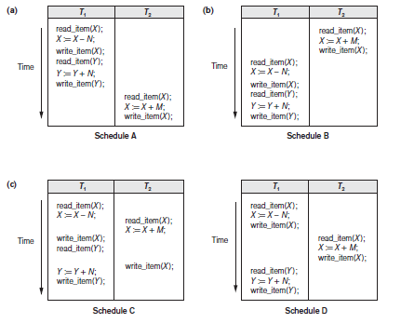
Contd..

Slide 27
Characterizing Schedules based on Serializability
Serial schedule:
–A schedule S is serial if, for every transaction T participating in the schedule, all the operations of T are executed consecutively in the schedule.
Otherwise, the schedule is called nonserial schedule.
Serializable schedule:
–A schedule S is serializable if it is equivalent to some serial schedule of the same n transactions.

Slide 28
Serial Schedules
T1 T2 T1 T2
read(X) Read(X)
X=X-N X=X+M
Write(X) Write(X)
Read(Y) read(X)
Y=Y+N X=X-N
Write(Y) Write(X)
Read(X) Read(Y)
X=X+M Y=Y+N
Write(X) Write(Y)

Slide 29
Non Serial Schedules
T1 T2 T1 T2
read(X) Read(X)
X=X-N X=X-N
Read(X) Write(X)
X=X+M Read(X)
Write(X) X=X+M
Read(Y) Write(X)
Write(X) Read(Y)
Y=Y+N Y=Y+N
Write(Y) Write(Y)

Slide 30
Conflicting Operations
Two operations in a schedule are said to have conflict if they satisfy all three of the following conditions:
They belong to different transactions
They Access the same data item X
At least one of the operations is write_item(X)

Slide 31
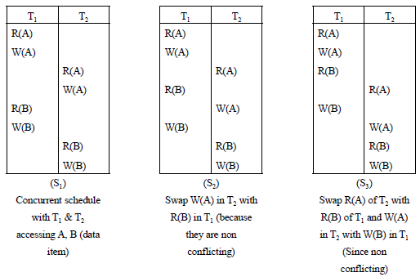
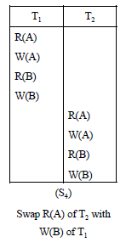
Contd..

Slide 32
Conflict Equivalence Schedules
If a schedule S can be transformed into a serial schedule S’ by a series of swaps of non-conflicting operations, we say that S and S’ are conflict equivalent.
Further, we say that a schedule S is conflict serializable if it is conflict equivalent to a serial schedule.
In our example S4 in the above example is a serial schedule and is conflict equivalent to S1. Hence S1 is a conflict serializable schedule.

Slide 33
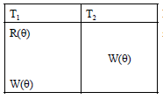
Contd..
In this schedule we cannot perform any swap between instructions of T1 and T2. Hence it is not conflict serializable

Slide 34
How Serializability is used for Concurrency Control
Being serializable is not the same as being serial
Being serializable implies that the schedule is a correct schedule.
–It will leave the database in a consistent state.
–The interleaving is appropriate and will result in a state as if the transactions were serially executed, yet will achieve efficiency due to concurrent execution.

Slide 35
Testing for Conflict Serializability
–Looks at only read_Item (X) and write_Item (X) operations
–Constructs a precedence graph (serialization graph) - a graph with directed edges
–An edge is created from Ti to Tj if one of the operations in Ti appears before a conflicting operation in Tj
–The schedule is serializable if and only if the precedence graph has no cycles.

Slide 36
Example

Slide 37
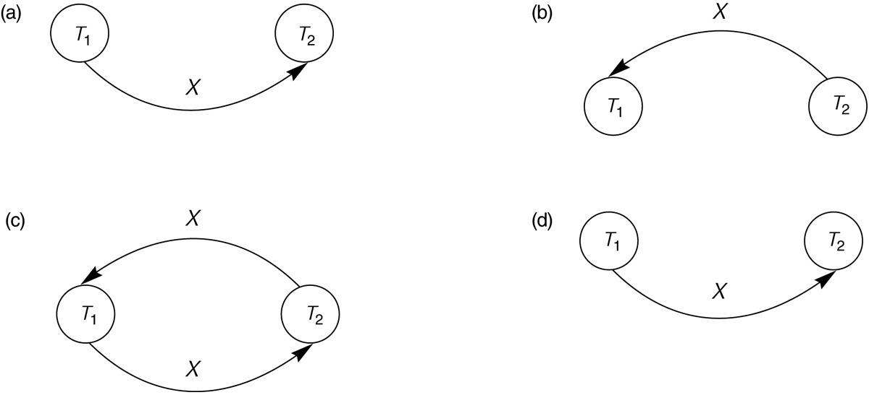
Constructing the Precedence Graphs
Constructing the precedence graphs for schedules A and D to test for conflict serializability.
–(a) Precedence graph for serial schedule A.
–(b) Precedence graph for serial schedule B.
–(c) Precedence graph for schedule C (not serializable).
–(d) Precedence graph for schedule D (serializable, equivalent to schedule A).

Slide 38
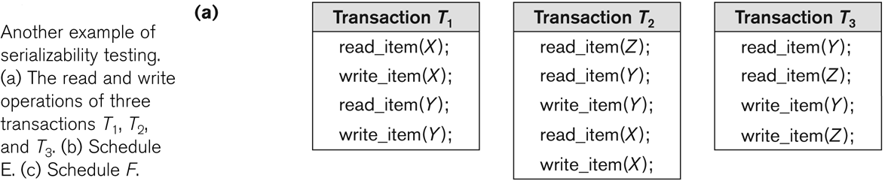
Another example of Serializability Testing

Slide 39
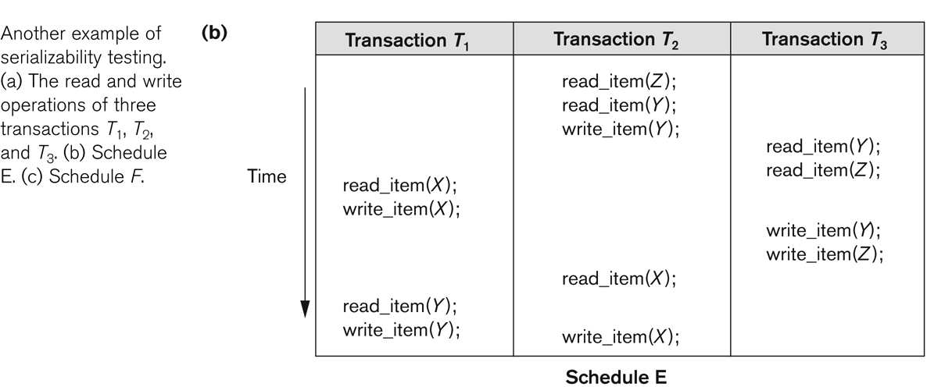
Another example of Serializability Testing
T1
T2
T3

Slide 40
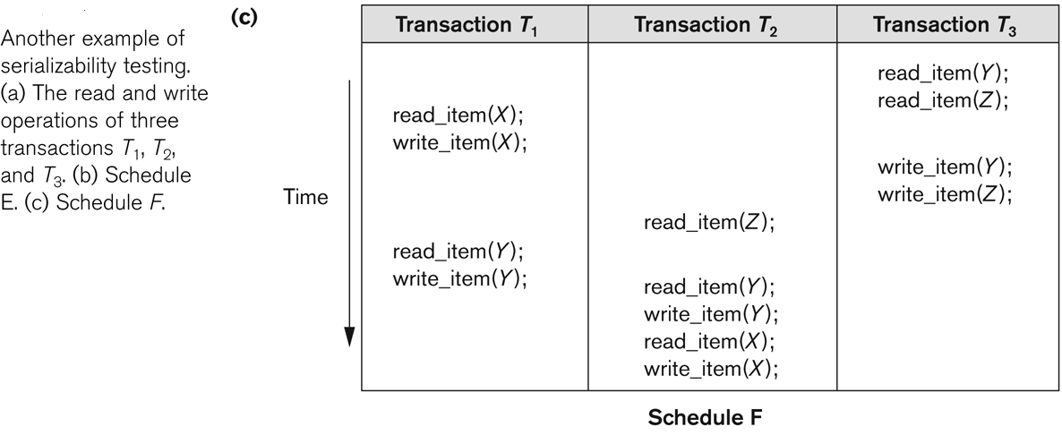
Another Example of Serializability Testing
T1
T2
T3

Slide 41
Database Concurrency Control
Purpose of Concurrency Control
–To enforce Isolation (through mutual exclusion) among conflicting transactions.
–To preserve database consistency through consistency preserving execution of transactions.
–To resolve read-write and write-write conflicts.
Example:
–In concurrent execution environment if T1 conflicts with T2 over a data item A, then the existing concurrency control decides if T1 or T2 should get the A and if the other transaction is rolled-back or waits.

Slide 42
Implementing Serializability
One way to ensure serializability is to allow the transactions to access the data items in a mutually exclusive manner.
This is to make sure that when one transaction access a data item no other transaction can modify that data item.
The following techniques implement mutual exclusion and control concurrency.
1. Lock-based protocols
2. Timestamp-based protocols

Slide 43
Locking Mechanism
Locking is an operation which secures
(a) permission to Read
(b) permission to Write a data item for a transaction.
–Example:
Lock (X). Data item X is locked in behalf of the requesting transaction.
Unlocking is an operation which removes these permissions from the data item.
Unlock (X): Data item X is made available to all other transactions.
Lock and Unlock are Atomic operations.

Slide 44
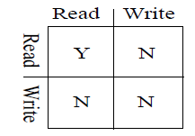
Contd..
Shared/Exclusive locks
–Shared mode: shared lock (X)
More than one transaction can apply share lock on X for reading its value, but no write lock can be applied on X by any other transaction.
–Exclusive mode: Write lock (X)
Only one write lock on X can exist at any time, and no shared lock can be applied by any other transaction on X.

Slide 45
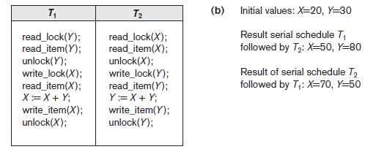
Contd..

Slide 46
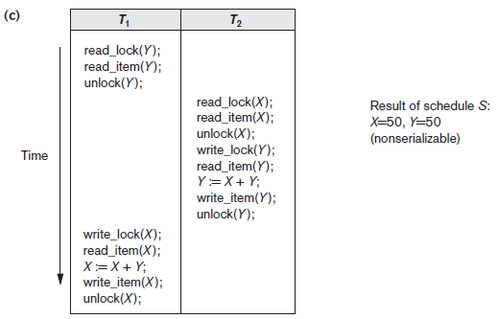
Contd..

Slide 47
Two Phase Locking Protocol
Two Phases:
–(a) Locking (Growing)
–(b) Unlocking (Shrinking).
Locking (Growing) Phase:
–A transaction applies locks (read or write) on desired data items one at a time.
Unlocking (Shrinking) Phase:
–A transaction unlocks its locked data items one at a time.
Requirement:
–For a transaction these two phases must be mutually exclusively, that is, during locking phase unlocking phase must not start and during unlocking phase locking phase must not begin.

Slide 48
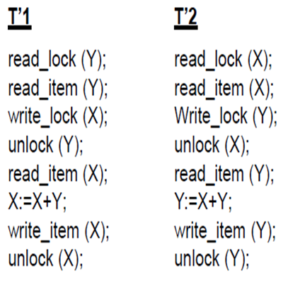
Contd..

Slide 49
Deadlock
The Mutual exclusion mechanism leads to deadlock situation.
For example, if transaction T_{i} holds a lock on a data item (Q) in X-mode and waits for a lock on another data item (P) which is locked by another transaction T_{j} in X-mode, further to release the lock on P, T_{j} must acquire a lock on Q, which is locked by T_{i}. This is a circular wait condition and results in a deadlock situation.

Slide 50
Deadlock Detection
Deadlock condition can be determined by a wait-for graph.
All transactions of the schedule become vertices.
And we have an edge between two transactions T_{i} and T_{j}. if T_{i} is waiting for T_{j} to release a lock on a data item.
If the graph has a cycle then we can say that the schedule will result in a deadlock.

Slide 51
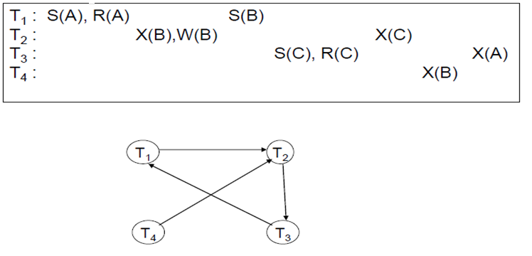
Contd..

Slide 52
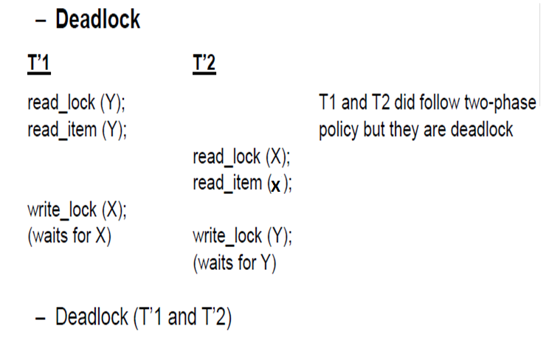
Contd..

Slide 53
Dealing with Deadlocks
Timestamp based:
Wait-Die: If Ti is older than Tj it is allowed to wait otherwise aborted.
Wound-wait: If Ti older than Tj allowed to run by aborting Tj else Ti will wait.
Priority based
Wait-Die: If Ti has higher priority than Tj it is allowed to wait otherwise aborted.
Wound-wait: If Ti has higher priority it is allowed to run by aborting Tj else Ti will wait.

Slide 54
Timestamp based concurrency control
Maintaining the ordering between every pair of conflicting transactions is significant.
If we select the ordering in advance, we can achieve serializability. Timestamping is a method to fix the ordering.
Each transaction is assigned a unique fixed timestamp.
If TS(Ti) < TS(Tj), this implies that Ti should be executed before Tj.

Slide 55
Contd..
The time-stamps determine the serializability order.
Each data item is associated with two timestamp values.
W-timestamp(Q) – represents the largest timestamp of any transaction that successfully executes Write(Q).
R-timestamp(Q) - which denotes the largest time stamp of any transaction that successfully executed Read(Q).
These values are updated whenever read(Q) or write(Q) are executed.

Slide 56
Contd..
Transaction Ti issues read(Q)
- If TS(Ti)<W-timestamp(Q), then Ti needs to read a value of Q that was already overwritten. Hence read operation is rejected and Ti is rolled back.
- If TS(Ti)>W-timestamp(Q), then the read operation is executed, and R-timestamp(Q) is set to the maximum of R-timestamp(Q)

Slide 57
Contd..
Transaction Ti issues write(Q)
- If TS(Ti)<R-timestamp(Q), then the value of Q that Ti is producing was needed previously and system assumed that value would never be produced. Hence the Write operation is rejected and Ti is rolled back.
- If TS(Ti)<W-timestamp(Q), then Ti is attempting to write an obsolete value of Q. Hence, this write operation is rejected and Ti is rolled back.
-Otherwise the write operation is executed and W-timestamp(Q) is set to TS(Ti).

